Slide 1
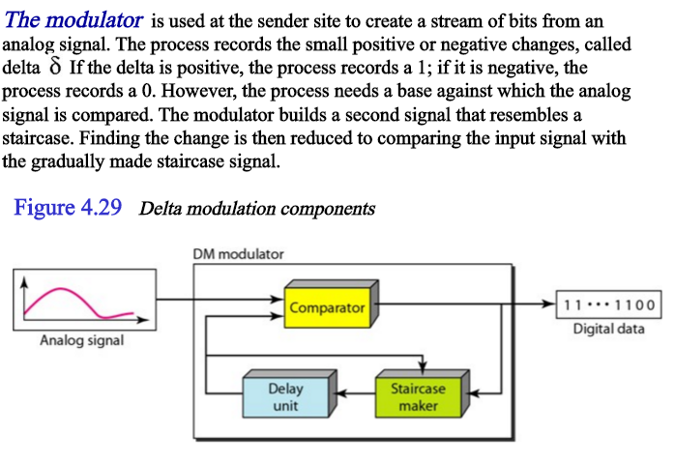
Module 3 - delta modulation

Slide 2
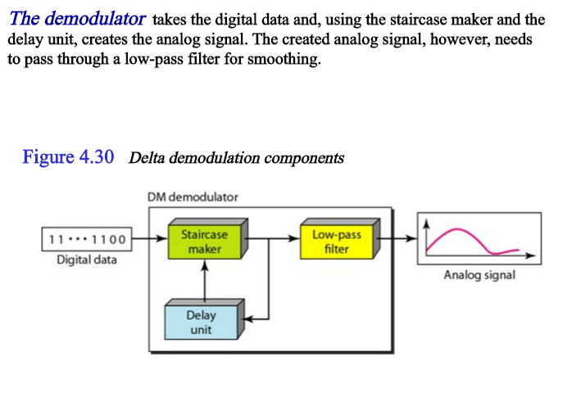

Slide 3
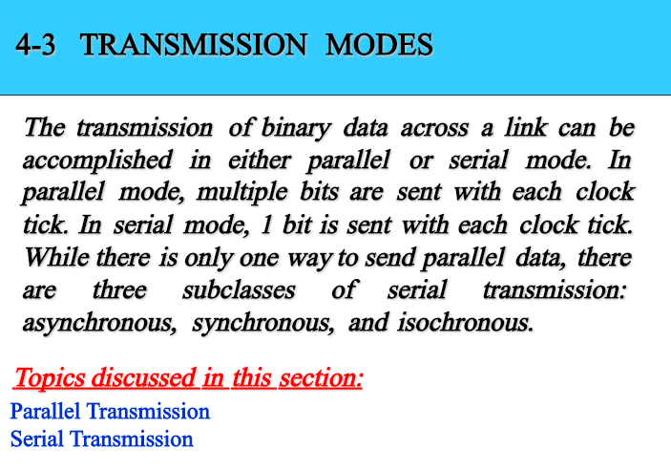
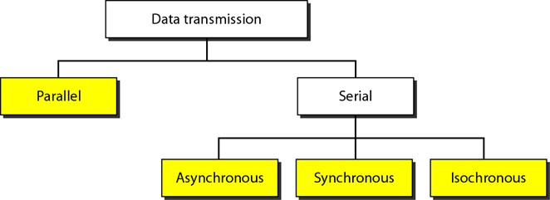

Slide 4
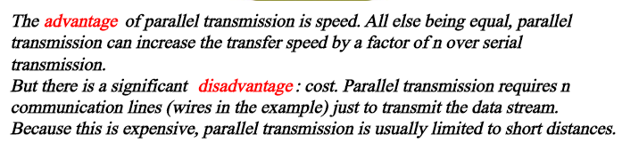
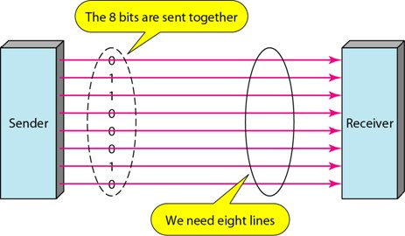

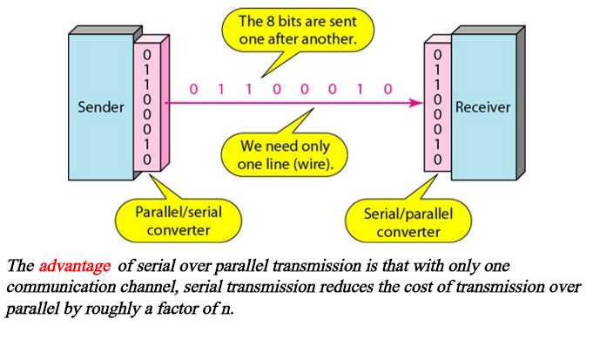

Slide 5
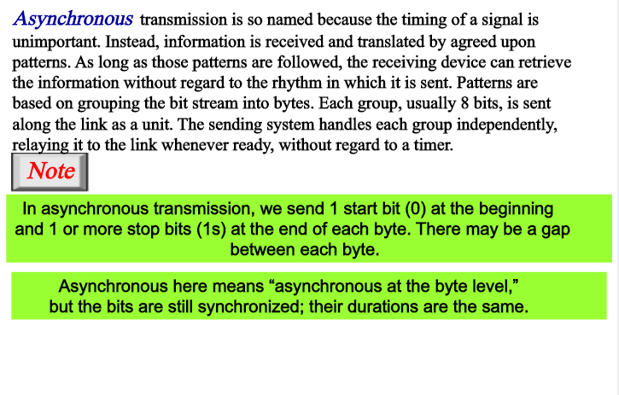

Slide 6

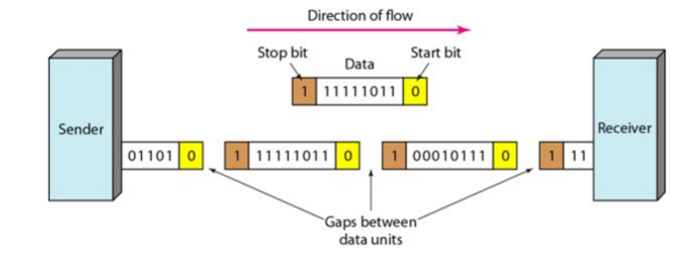
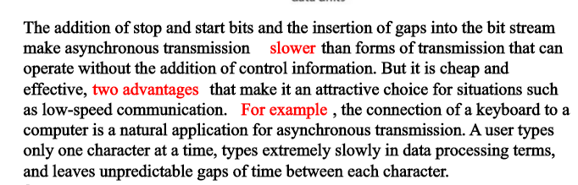

Slide 7
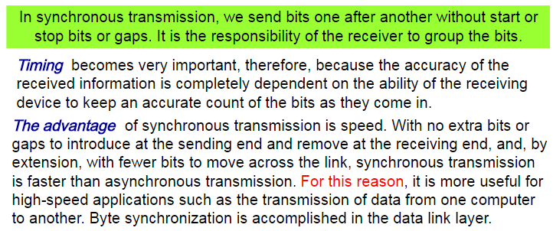
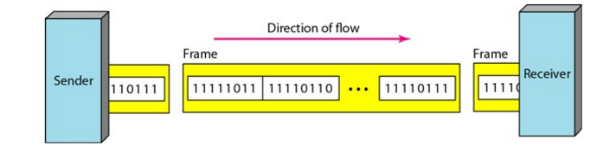

Slide 8
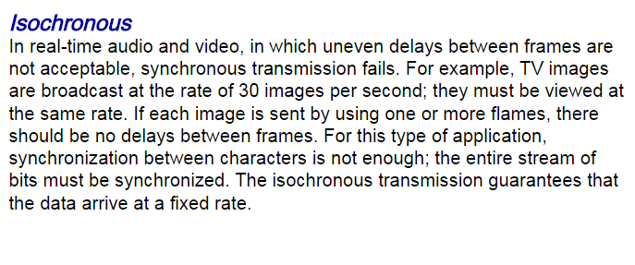

Slide 9
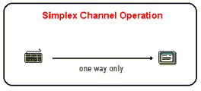
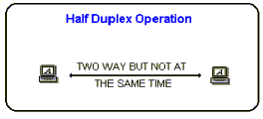
Modes of Channel Operation
Simplex Data in a simplex channel is always one way. Simplex channels are not often used because it is
not possibleHalf Duplex to send back error or control signals to the transmit end.
It's like a one way street.
An example of simplex is Television, or Radio
Half Duplex
A half-duplex channel can send and receive, but noOnly one end transmits at a time, the other end receives. t at the same time. It's like a one-lane bridge where two way traffic must give way in order to cross.
Another example of half-duplex is talk-back radio, and CB Radio (Citizens Band). You might have seen movies where truckies (drivers of very big trucks) communicate to each other, and when they want the other person to speak they say "over". This is because only one person can talk at a time.

Slide 10
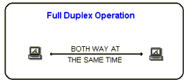
Full Duplex
Data can travel in both directions simultaneously. There is no need to switch from transmit to receive mode like in half duplex. Its like a two lane bridge on a two-lane highway. Of course, in the world of data communications, full duplex allows both way communication simultaneously. An example can be a consumer which uses a cable connection to not only receive TV channels, but also the same cable to support their phone and Internet surfing. All these activities can occur simultaneously.

Slide 11
Circuit Switching
uses a dedicated path between two stations
has three phases
establish
transfer
disconnect
inefficient
channel capacity dedicated for duration of connection
if no data, capacity wasted
set up (connection) takes time
once connected, transfer is transparent

Slide 12
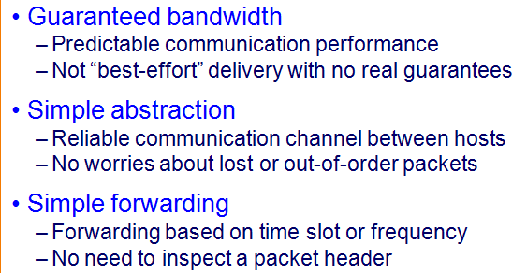
Advantages of Circuit Switching
Disadvantages of Circuit Switching
Wasted bandwidth
Bursty traffic leads to idle connection during silent period
Unable to achieve gains from statistical multiplexing
Blocked connections
Connection refused when resources are not sufficient
Unable to offer “okay” service to everybody

Slide 13
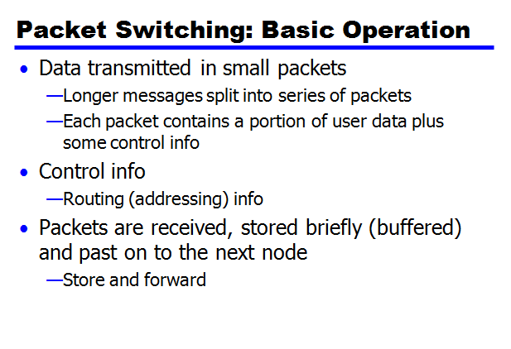
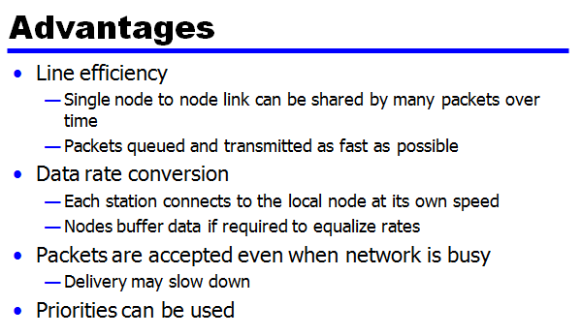

Slide 14
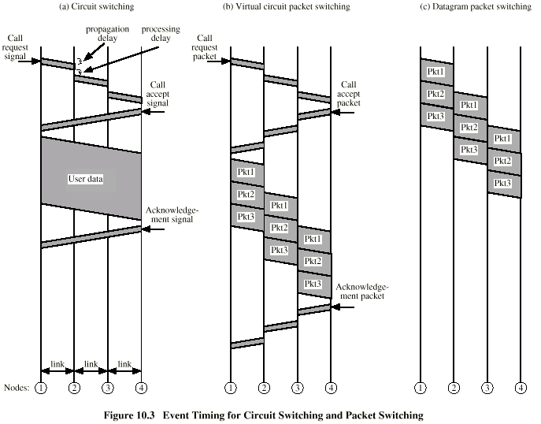

Slide 15
